Slide 1
WAKE N BAKE
YOU DON’T NEED A SILVER FORK TO
EAT GOOD FOOD
By:-
Bhuta Nachiket Mehul (1598004)
Chandura Dishant Tushar (1598005)
Desai Dhairya Rahul (1598006)
Guided By:-
Mr. Manish R. Solanki
Technician:- Mrs. Reshma Parab

Slide 2
TOPICS TO BE COVERED
Problems Faced
Introduction
Existing Solutions
Our Solutions
Technological Requirements
Literature Survey
System Design
Libraries
Results
Features
Limitations
Applications
Future Scope
Conclusion
References

Slide 3
SURVEY OF NIGHT LIFE

Slide 4
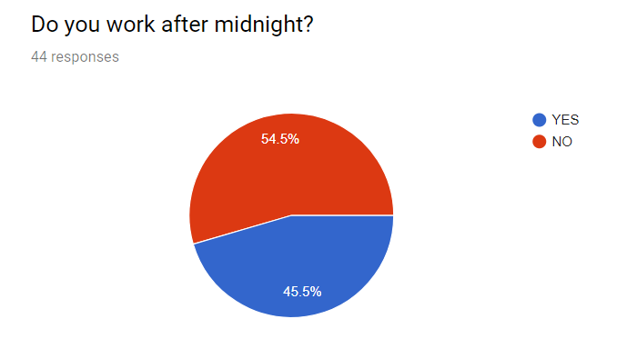

Slide 5
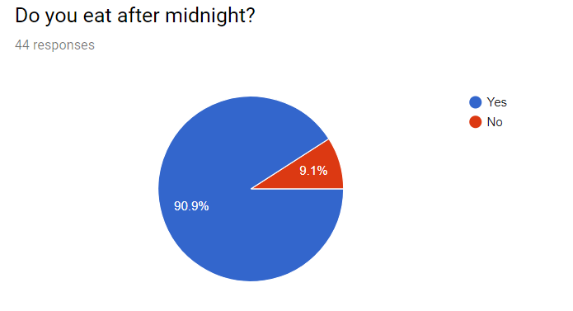

Slide 6
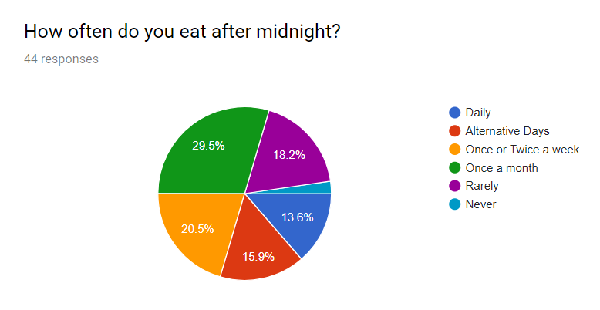

Slide 7
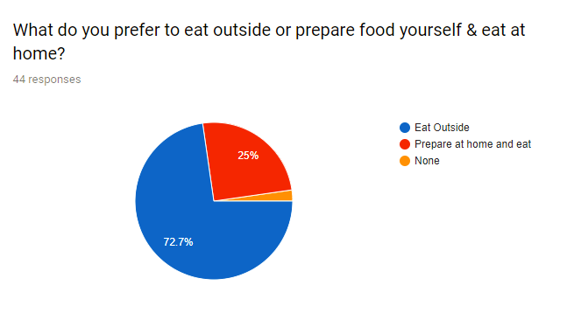

Slide 8
PROBLEMS FACED
Feel HUNGRY at Night ?
Bored of EATING same food ?
Missing MOTHER’S loved food ?
Can’t COOK food by yourself ?
Want to eat some FRESH AND HEALTHY food ?

Slide 9
INTRODUCTION
An interface to search for fast food joints/restaurants at midnight or during the time between 1-6 am.
Provide local food vendors with a way to connect with customers in their region or in their area.
Browse through the photos, reviews and ratings of the food joints.
Use the map feature to guide themselves there.

Slide 10




EXISTING SOLUTIONS
Zomato
Swiggy
Food Panda
Box8

Slide 11
Modules

Slide 12
1. NIGHT FOOD
Collaborating all the local food joints & vendors which are open up till 6am in the morning.
Location of each food joints & vendor.
Details of the vendor & food joints.
Timings of each & every vendor/food joints and bookmark them according to your wish.

Slide 13
2. GOOGLE PLACES
Browse through different food joints and restaurants during the day time.
Get the places which are registered in Google Places.
Eradicate users using different applications to search food places in the day time.

Slide 14
3. TIFFIN VENDORS
Collaborates all the home food vendors.
Home made foods are provided.
Students living in hostels, PG or those living alone who are all tired of eating fast foods or junk food and cannot cook food on their own, can use this module.

Slide 15
PROBLEMS SolvED
Feel HUNGRY at Night ? – Solved.
Bored of EATING same food ? – Solved.
Missing MOTHER’S loved food ? – Solved.
Can’t COOK food by yourself ? – Solved.
Want to eat some FRESH AND HEALTHY food ? – Solved.

Slide 16
Technological Requirements (Hardware)
Mobile Phone
Should be an Android powered phone.
API version should be 19 (KitKat) or above.
Should have an Internet Connection.
For Development, we used:-
Windows
Microsoft® Windows® 7/8/10 (32- or 64-bit).
3 GB RAM minimum.
2 GB of available disk space minimum.
1280 x 800 minimum screen resolution.

Slide 17






Technological Requirements (Software)
Android Studio
https://developer.android.com/studio/index.html
XAMPP
https://www.apachefriends.org/download.html
Firebase
https://firebase.google.com/
Postman
https://www.getpostman.com/apps
Sublime Text
https://www.sublimetext.com/3
Git
https://git-scm.com/

Slide 18
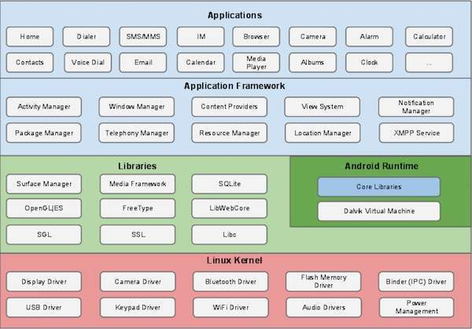
Literature Survey
Architecture of Android OS

Slide 19
Key features of Android OS
Beautiful UI
Connectivity
Storage
Web Browser
Multi-Tasking
Media Support
Multi-Touch
Messaging
Multi- Language
Resizable Widgets
WiFi- Direct
Android Beam

Slide 20
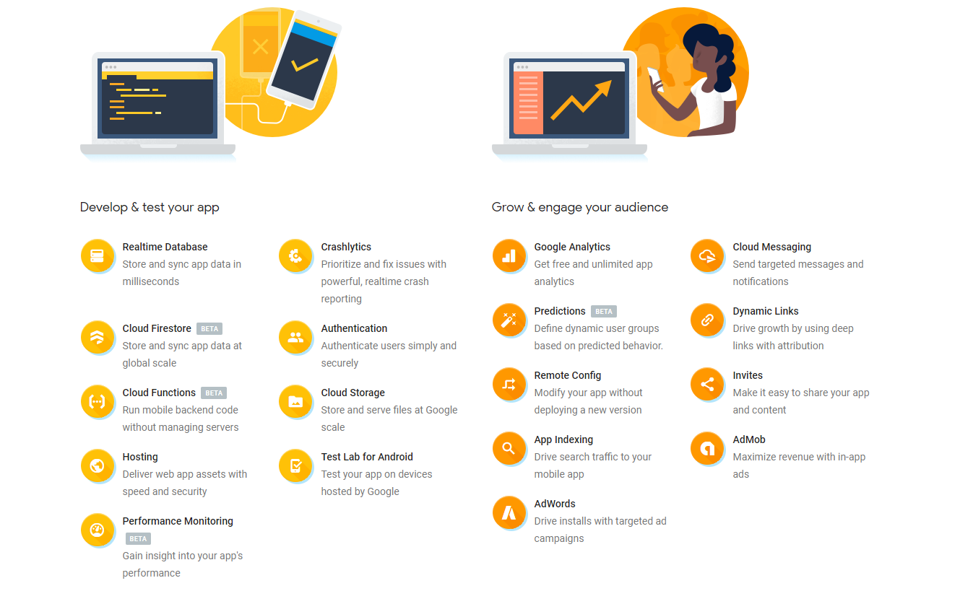
FIREBASE

Slide 21
PHP
An acronym for "PHP: Hypertext Preprocessor“.
Server Scripting Language.
A widely-used, open source scripting language.
Powerful tool for making dynamic and interactive Web pages.

Slide 22
Version control system
Version control systems are a category of software tools that help a software team manage changes to source code over time.
Version control software keeps track of every modification to the code in a special kind of database.
If a mistake is made, developers can turn back the clock and compare earlier versions of the code to help fix the mistake while minimizing disruption to all team members.

Slide 23
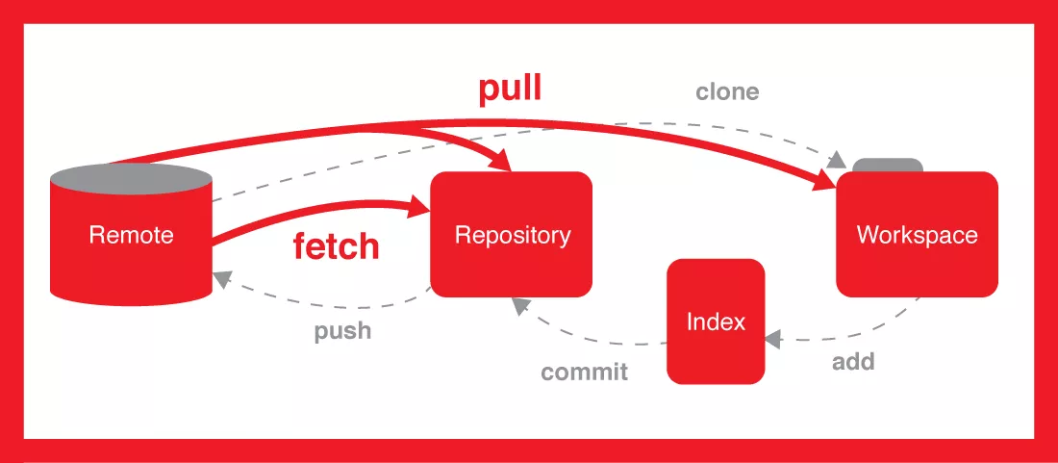
VCS USING GIT
Architecture of Git

Slide 24
GitHUb
Single largest host for Git repositories & central point of collaboration for millions of developers and projects.
Web - based Git version control repository hosting service.
offers all of the distributed version control and source code management (SCM) functionality of Git as well as adding its own features.

Slide 25
APIs
Google Play Services
Google Maps API
Google Places API
RESTful API

Slide 26
Survey of food joints

Slide 28
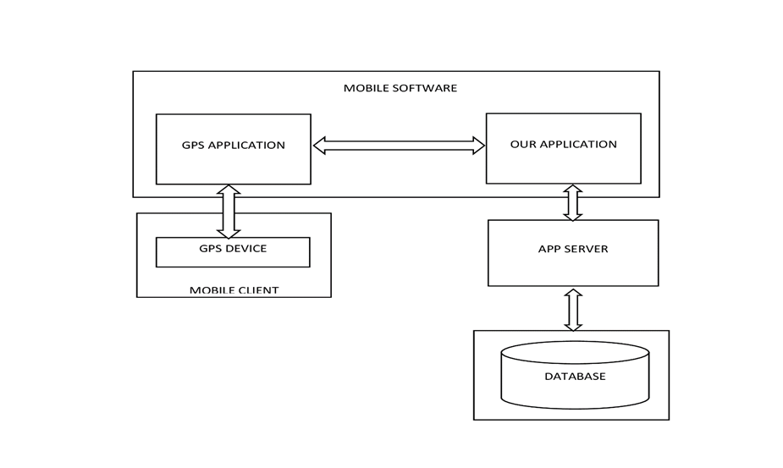
SYSTEM DESIGN
Basic Architecture of the Application

Slide 29
libraries
Android Support Library
Room Persistence Library
Recycler View Library
FirebaseUI
Auth
Library
FirebaseUI
Database
Library
Material Search Bar
Pin View Library
Simple Rating Bar
Smart Tab Layout
Android Ripple Background
Retrofit
Picasso

Slide 30

RESULTS

Slide 31

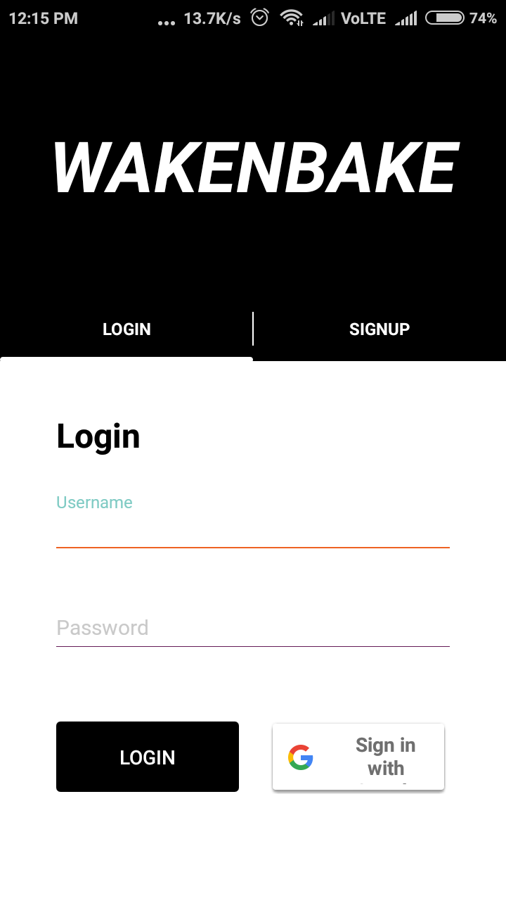
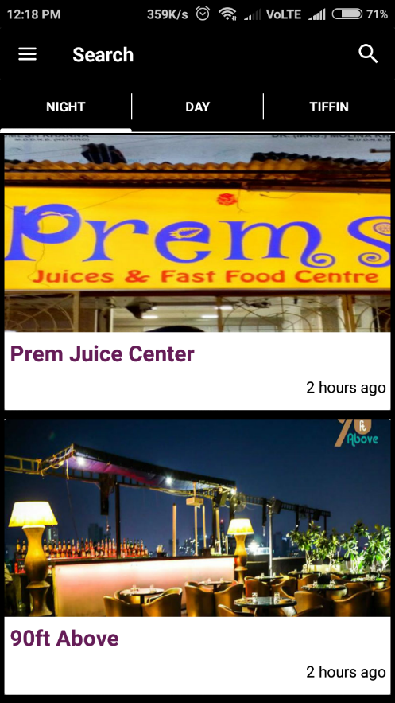
Splash Screen
Login Screen
Night Module

Slide 32
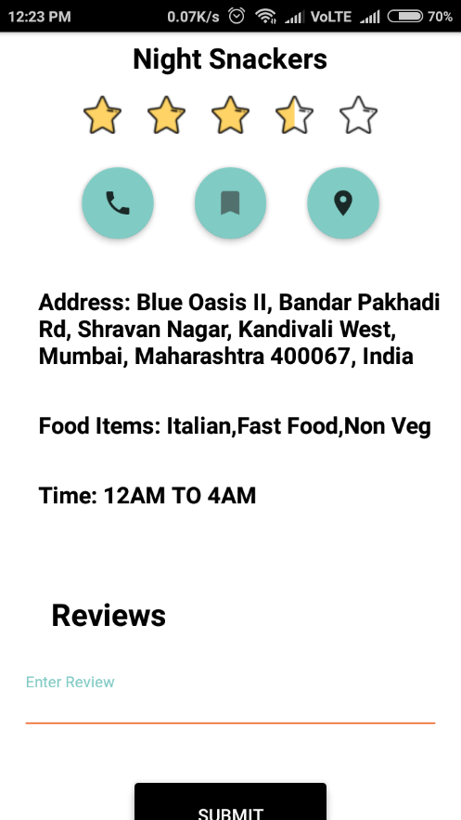
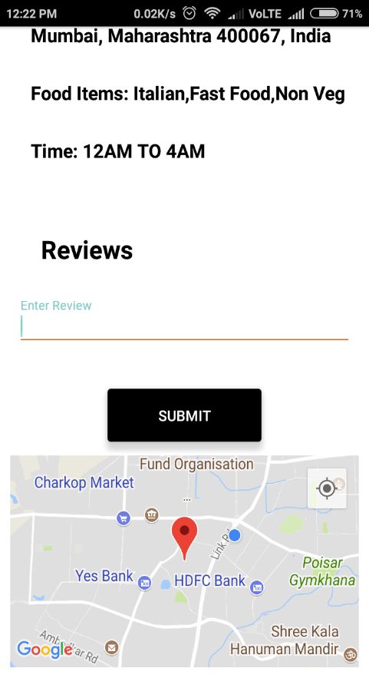
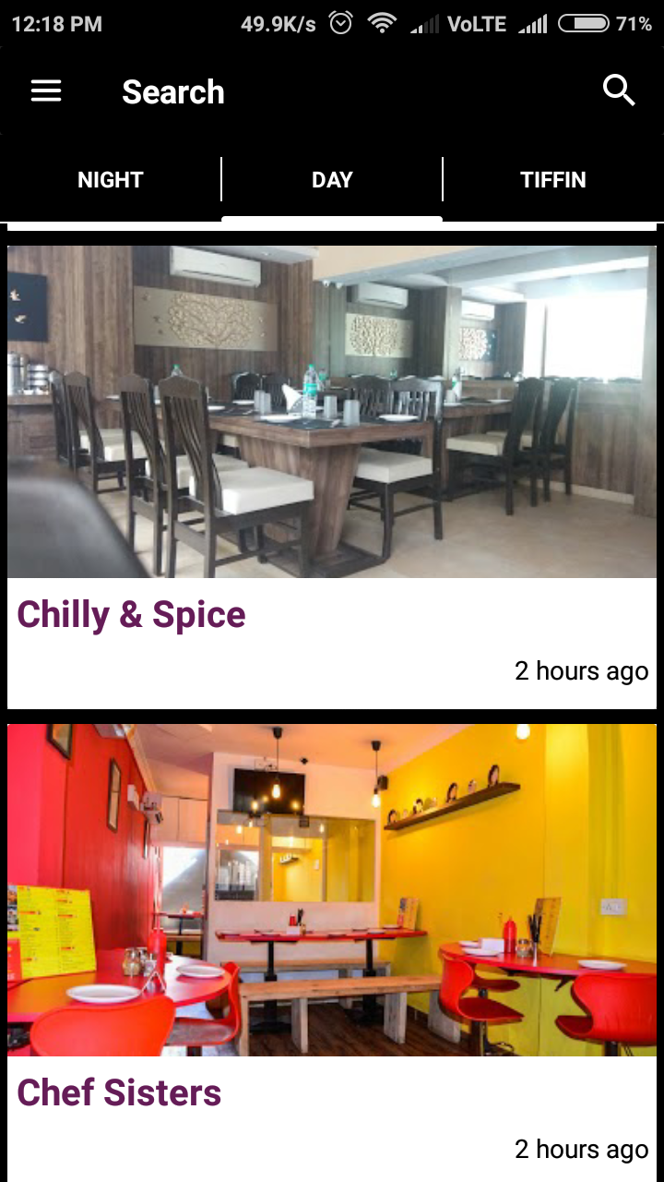
Details
Location Snippet
Day Module

Slide 33
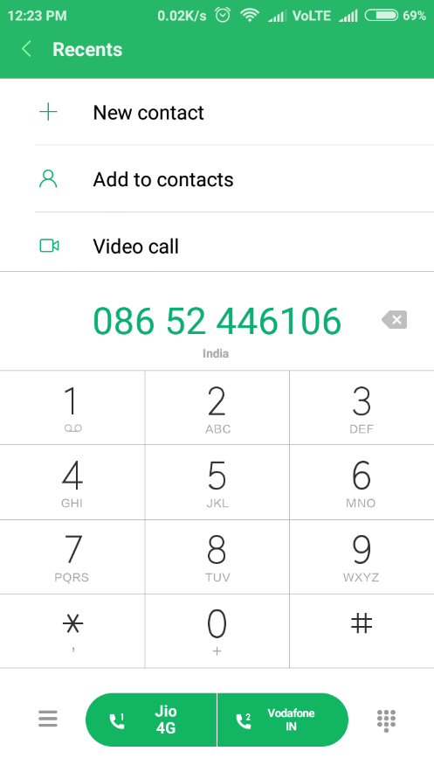
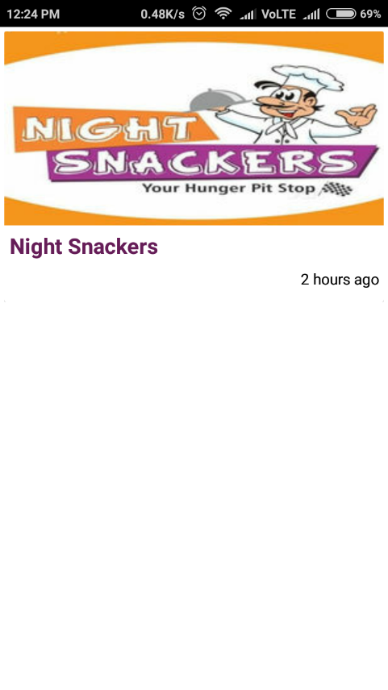
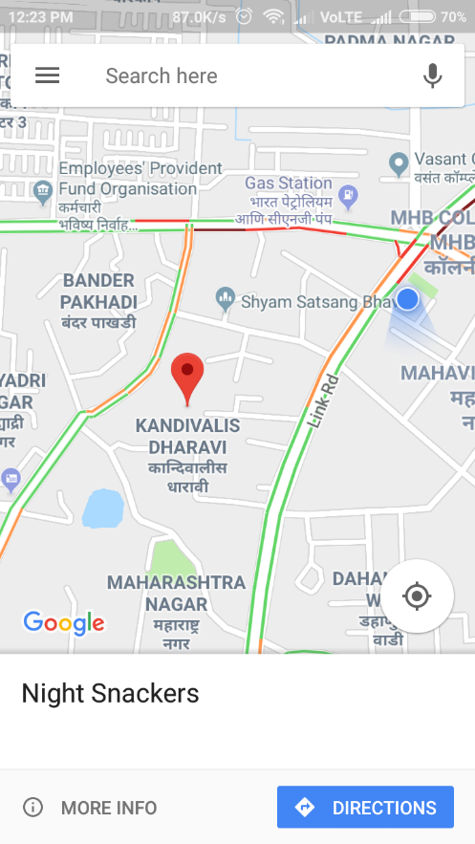
Calling
Bookmarks
Location
On Maps

Slide 34
Features
Easily search for food joints.
View details of food joints near you.
View & give ratings, reviews.
Maintain an easy reference list of your favorites places with bookmarks.
Use map view to explore food joints around you.

Slide 35
Limitations
This application applicable for particular locality which is between Borivali and Malad.
Home delivery feature is not available.
Addresses & location of tiffin vendors are not provided right now.

Slide 36
applications
Find local food joints near you.
Select food joints based on reviews, ratings and also on the type of cuisines select by user.

Slide 37
Future scope
Further extended to the food joints available throughout the city.
Used by home-made food vendors to set up their respective businesses in various types of cuisines.
Online ordering can be started using this application by the food joints.
More advanced search feature by taking pin code as the input.
Home delivery feature can also be added.
Can be extended to support more devices like the tablets and iOS devices.

Slide 38
CONCLUSION
Basic understanding of development and challenges of mobile application development & can be managed by using VCS (Version Control System).
An easy to use application for searching the places during day and night time as well as providing the details of the home-made food vendors.
Further extended to other devices from Android by using some cross platform technologies such as React-Native, Flutter, etc.

Slide 39
REFERENCES
[1]. Rajinder Singh, Department of Computer Science and Applications DCSA Panjab University SSGRC Hoshiarpur, An Overview of Android Operating System and Its Security Features, dated February 2014. https://pdfs.semanticscholar.org/11f4/b8efd1a9af746f17ac5e8d6a789bd3c3a9b7.pdf
[2]. Bob Brown, A Gentle Introduction to PHP, School of Computing and Software Enginering, copyright in 2002. http://ksuweb.kennesaw.edu/~rbrow211/papers/php1.html
[3]. GeekyAnts, Introduction to Firebase, blog post published on December 28, 2017. https://hackernoon.com/introduction-to-firebase-218a23186cd7
[4]. Stefan Otte, Introduction to Version Control System, Computer Systems and Telematics Institute of Computer Science Freie Universitat Berlin, Germany. https://pdfs.semanticscholar.org/5093/c4b55ad419379ad22e0c60008f133a2b6e3b.pdf
[5]. A book of Version Control System using Git by Jon Loeliger published in May 2009. https://www.foo.be/cours/dess20122013/b/OReilly%20Version%20Control%20with %20GIT.pdf
[6]. Xiao Li, A Tutorial for Git and Github, Department of Informatics, University of Zurich. https://www.ifi.uzh.ch/dam/jcr:ff780599d5e24d05b9231c333cbf2842/A%20Tutorial %20for%20GitHub.pdf
[7]. A Presentation by Pratheepan Raveendranathan on Introduction to Google API, University of Minnesota Duluth. https://www.d.umn.edu/~rave0029/research/GoogleAPI.ppt
[8]. Pankti Doshi, Pooja Jain, Abhishek Shakwala on Location Based Services and Integration of Google Maps in Android, NMIMS University, dated March 3, 2014. http://www.ijecs.in/issue/v3-i3/30%20ijecs.pdf

Slide 40
Thank you

Slide 41

questions

